Slide 1
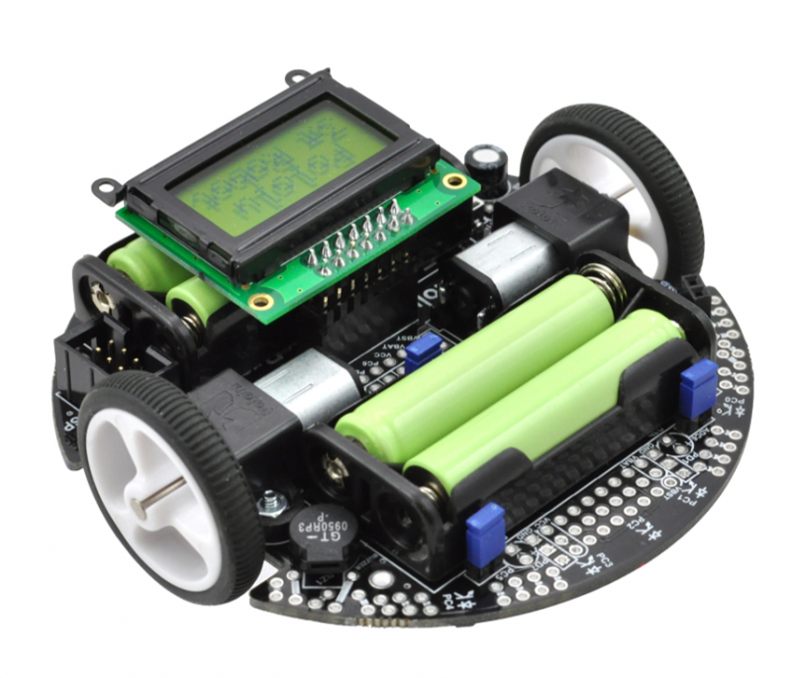
CIS 308 Final Project
Dylan Staatz & Trey Schmidt

Slide 2
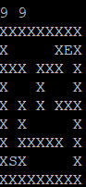
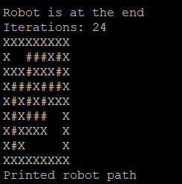
Goal: To solve a maze by implementing the Flood Fill algorithm
Input:
Output:

Slide 3
Flood Fill Algorithm
Traversing a maze
Can solve as you go
Needs only the start and end locations
Works by emanating outward from the end location based on the robot’s knowledge of walls. The robot then moves, and repeats.

Slide 4
Demonstration
This is the part where we show you it works
Simple 4x4 maze
Let’s do a 20x20 too, because why not?

Slide 5
Thank you! Any Questions?

